Slide 1


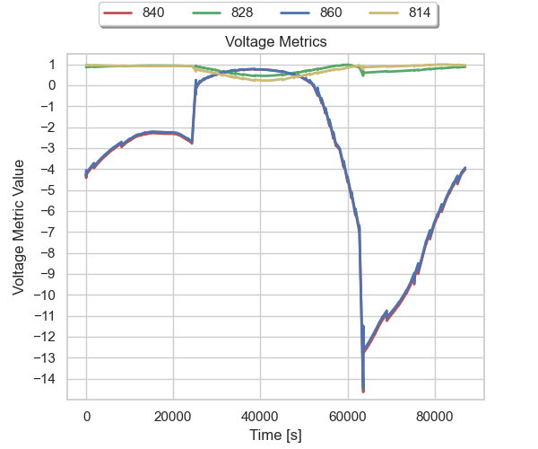
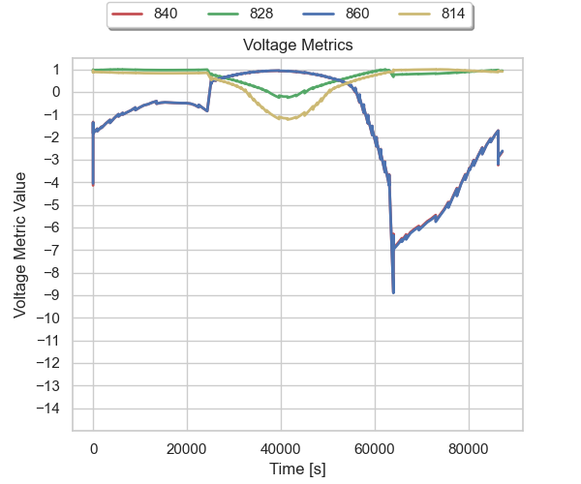
Storage Sizing and Placement in Distribution Grids Will Vining, Ujjwol Tamrakar, John Eddy
Purpose
Metrics
Identify optimal sizing and placement of Energy Storage assets on a distribution grid while considering:
Grid physics
Grid reliability
Disruptions caused by extreme events
Metrics are captured and aggregated across the grid to quantify the impact of each storage configuration and allow comparison of different configurations.
Metrics are normalized so that different quantities of interest can be compared directly. For example, voltage levels across the grid can be “traded-off” against line loading, energy service, or any other quantity of interest.
Simulation Overview
Energy Management System
Example - IEEE 34 Bus Test Feeder
possible storage locations
Reliability Simulation
Grid Simulation
OpenDSS
Storage Controller
Storage Controller
Storage Controller
Threat model
Load Simulation
Photovoltaic Systems
Metrics for voltage quality at 4 busses from system. The metric values become increasingly negative as the limits on voltage are exceeded.
The dual storage configuration performs better than the single location option.
A HELICS-based co-simulation couples:
OpenDSS grid simulation
Grid reliability simulation
Energy management system simulation
Storage controller simulations
The simulation will be distributed as an open source component of Sandia’s QuESt tool.
Analysis & Optimization Overview
Storage at bus 814 only
Storage at bus 814 & 840
Storage Device Configuration Options
Storage Device Configuration Options
Storage Device Configuration Options
OpenDSS grid model
Storage Device Configuration Options
Future Work
Simulate building energy demand accounting for environmental and grid conditions.
Simulate threats to the grid such as extreme weather.
Include different energy storage controls as part of the optimization parameters.
Enumerate grid configurations
Simulate each grid configuration
Report optimal configuration and tradeoffs
Aggregate metrics
We would like to thank the DOE Office of Electricity energy storage program managed by Dr. Imre Gyuk for funding this work
SAND2022-13072 C

